Slide 1
RE/MAX Housing Prediction Model
August 2022

Slide 2
Executive Summary
Question | What model can most accurately predict housing prices using data scraped from online resources?
High Level Summary | Tree-based methods had the lowest validation error
Next Steps | Implement the tuned XGBoost algorithm to predict housing prices
Data | Training/Validation Sources: CollegeCr.csv, Edwards.csv, OldTown.csv Test Sources: CollegeCr.test.csv, Edwards.test.csv, OldTown.test.csv
Watchouts | Columns were not consistently available between datasets Missing values required imputation Model training excluded anomalous records

Slide 3
Data Quality Remediation and Transformations
Derived Neighborhood variable from file names.
Split into multiple variables:
Exterior → Exterior1st, ExteriorQual, ExteriorCond
LotInfo → LotConfig, LotShape, LotArea, LotFrontage
Removed:
3 full row duplicates
Anamoly with YrSold 2001 and YearBuilt 2004
Utility, BsmtUnfSF, and KitchenAbvGr columns
Filled in empty:
BsmtQual, BsmtFinType1, and GarageType with NA
LotFR3 with 0

Slide 4
Model Families Evaluated
Family | Objective
Linear Regression with Stepwise Selection | Add or remove one variable at a time and evaluate model accuracy
Shrinkage Methods | Shrink the coefficient estimates towards zero by applying a penalty
Tree-Based Methods | Stratify or segment the predictor variable space into several simple regions with predicted responses

Slide 5
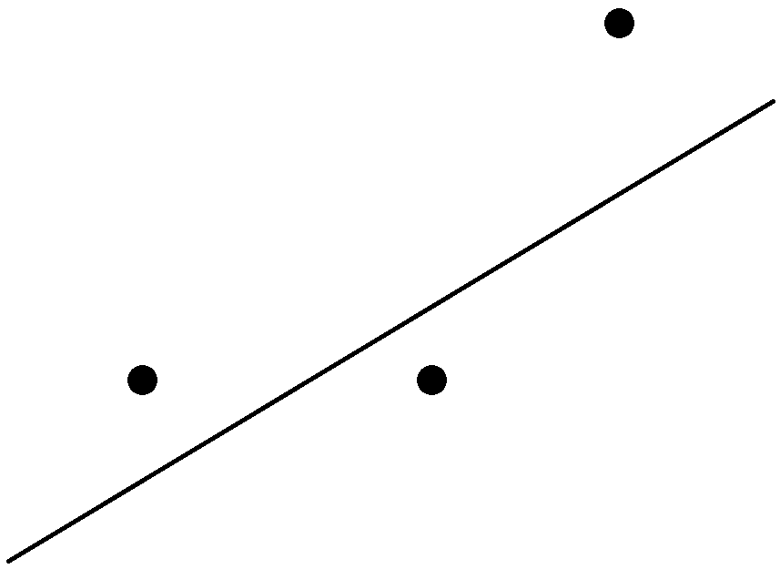







Model Comparison Measure
Mean Squared Error (MSE): The squared distance of each actual observed value $y_{i}$ from the predicted value divided by the number of observations.
Measured vertically
$MSE=\frac{d_{1}^{2}+d_{2}^{2}+d_{3}^{2}}{3}$
$$y_{3}$$
$$d_{3}$$
$$y_{1}$$
$$d_{2}$$
$$d_{1}$$
$$y_{2}$$

Slide 6
Splits for Model Evaluation
Training | Validation | Test
Optimize each model against this set | Compare models | Predict
CollegeCr.csv Edwards.csv OldTown.csv | CollegeCr.test.csv Edwards.test.csv OldTown.test.csv

Slide 7
Mean Squared Error Comparison
Family:

Slide 8
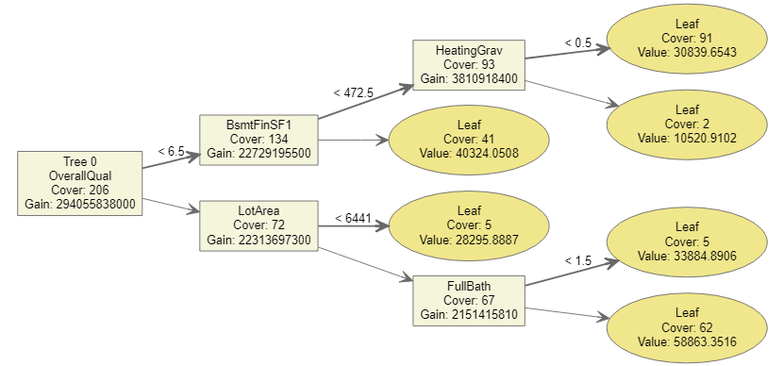
XGBoost Overview
eXtreme Gradient Boosted trees
Ensemble method
Based on predicting errors from previous models in algorithm
Learns slowly to avoid overfitting

Slide 9
XGBoost Model Results
Remaining 54 features had <0.5% importance

Slide 10
Parameter Tuning

Slide 11
Next Steps
Provide predictions from current test dataset.
Deploy XGBoost model predict future sale prices.

Slide 12
Appendix

